Slide 1

Hands-on Experiences on AI Implementation
Module #12 – Industry Scale Production

Slide 2
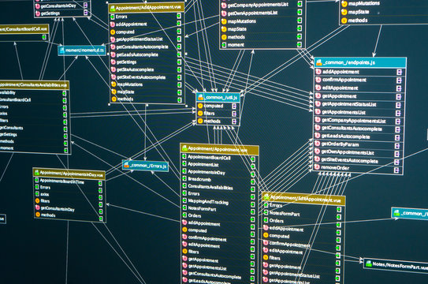
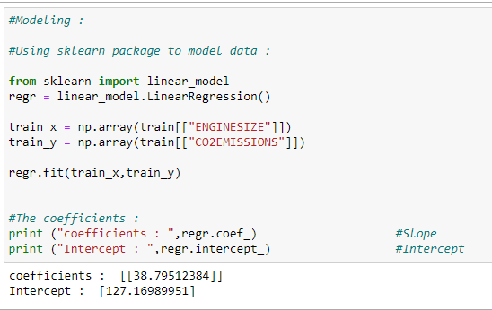
Simple one-time research (not production Level) Development Requirement
Data Management Code
Connect, Store Process & Send
~30%
Data Analytics Code
For AI Solution
~70%

Slide 3
Production Requirement for Single Solution
Production Scale Solution:
Minimal human intervention
Automatic data management and connectivity between databases and servers
Capable of running repeatedly
Auto-scalable for different data sizes
Visualization Dashboard for Decision Making
Administration Capability
Fast code deploy system
All of the above inside an fully packaged application either
Desktop based or
Cloud Based

Slide 4
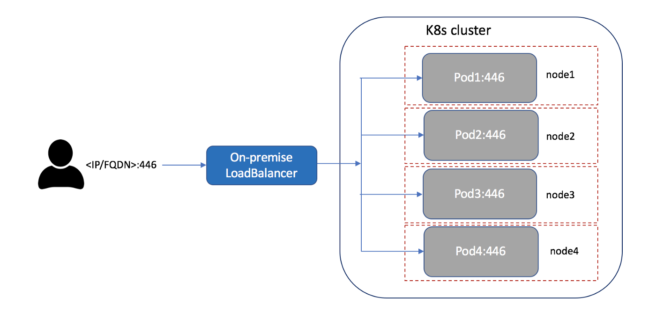
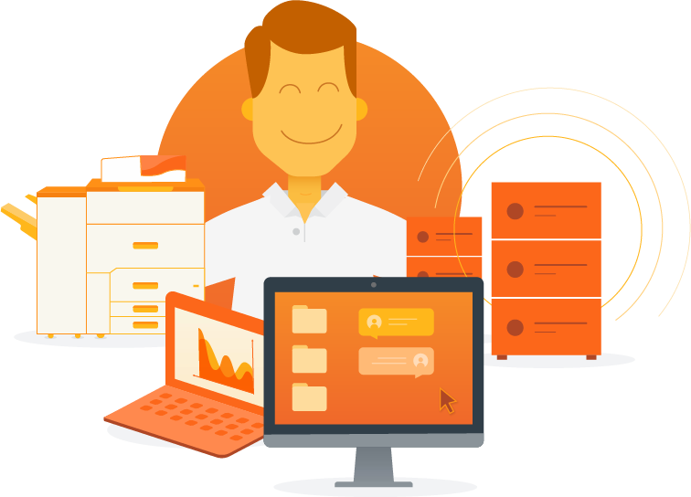
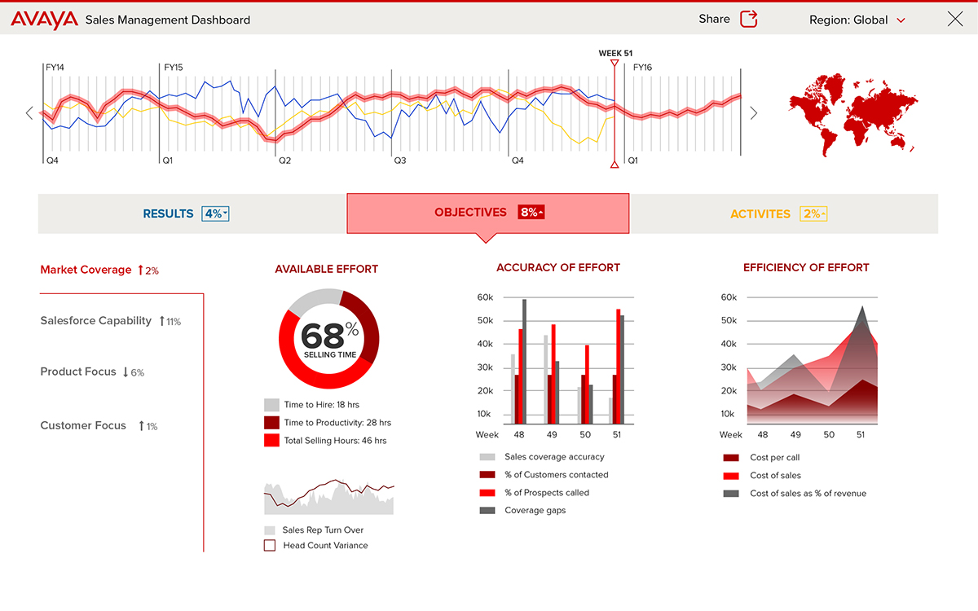
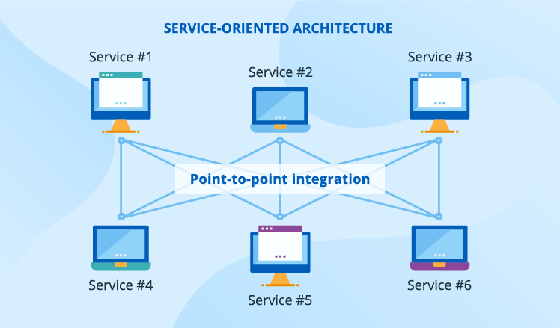
Development Requirements for Production Scale
Data Management Code
Connect, Store & Send (~20%)
Data Analytics Code
For AI Solution (~40%)
Load Balancing Application
For Scalability (~10%)
Admin Application
To manage solution 5%
Visualization Application for Decision Make ~15%
Application Integration Code
To integrate all 5 applications~10%

Slide 5
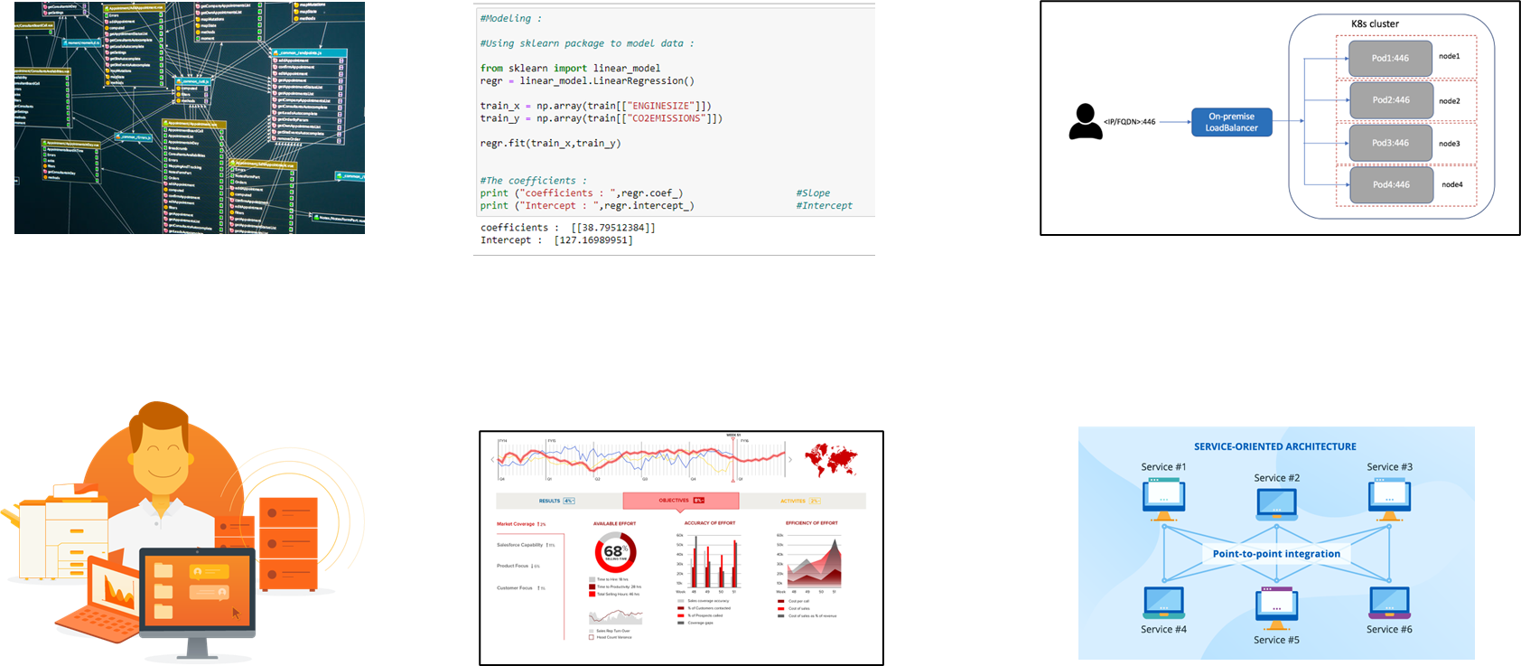
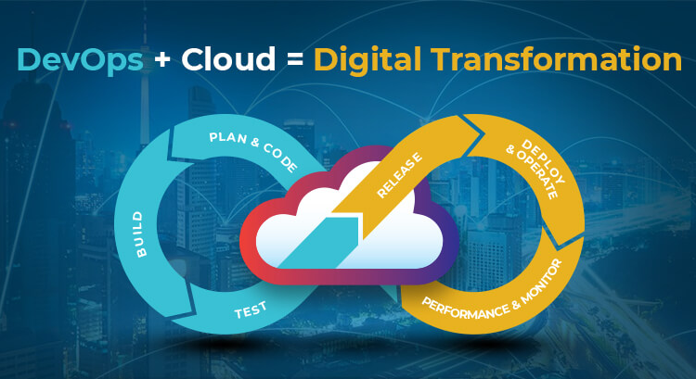
Development Requirements for Production Scale for Cloud based
Cloud Modification
Cloud Modification
Cloud Modification
Data Management Code
Connect, Store & Send (~20%)
Data Analytics Code
For AI Solution (~40%)
Load Balancing Application
For Scalability (~10%)
Cloud Application
(~10%)
Admin Application
To manage solution 5%
Visualization Application for Decision Make ~15%
Application Integration Code
To integrate all 5 applications~10%
Cloud Modification
Cloud Modification
Cloud Modification

Slide 6


